Slide 1
IOT Final Demo
Yaohan Teng

Slide 2
1. My Topic
Face recognition attendance check

Slide 3
2. Motivation
(1) More efficient and easier way to do attendance check.
(2) Save time for classes.

Slide 4
3. My design
1. App : Android Studio (Java)
2. Database: SQLite Database.
3. Face recognition : Baidu Api
https://ai.baidu.com/ai-doc/FACE/7k37c1ucj

Slide 5
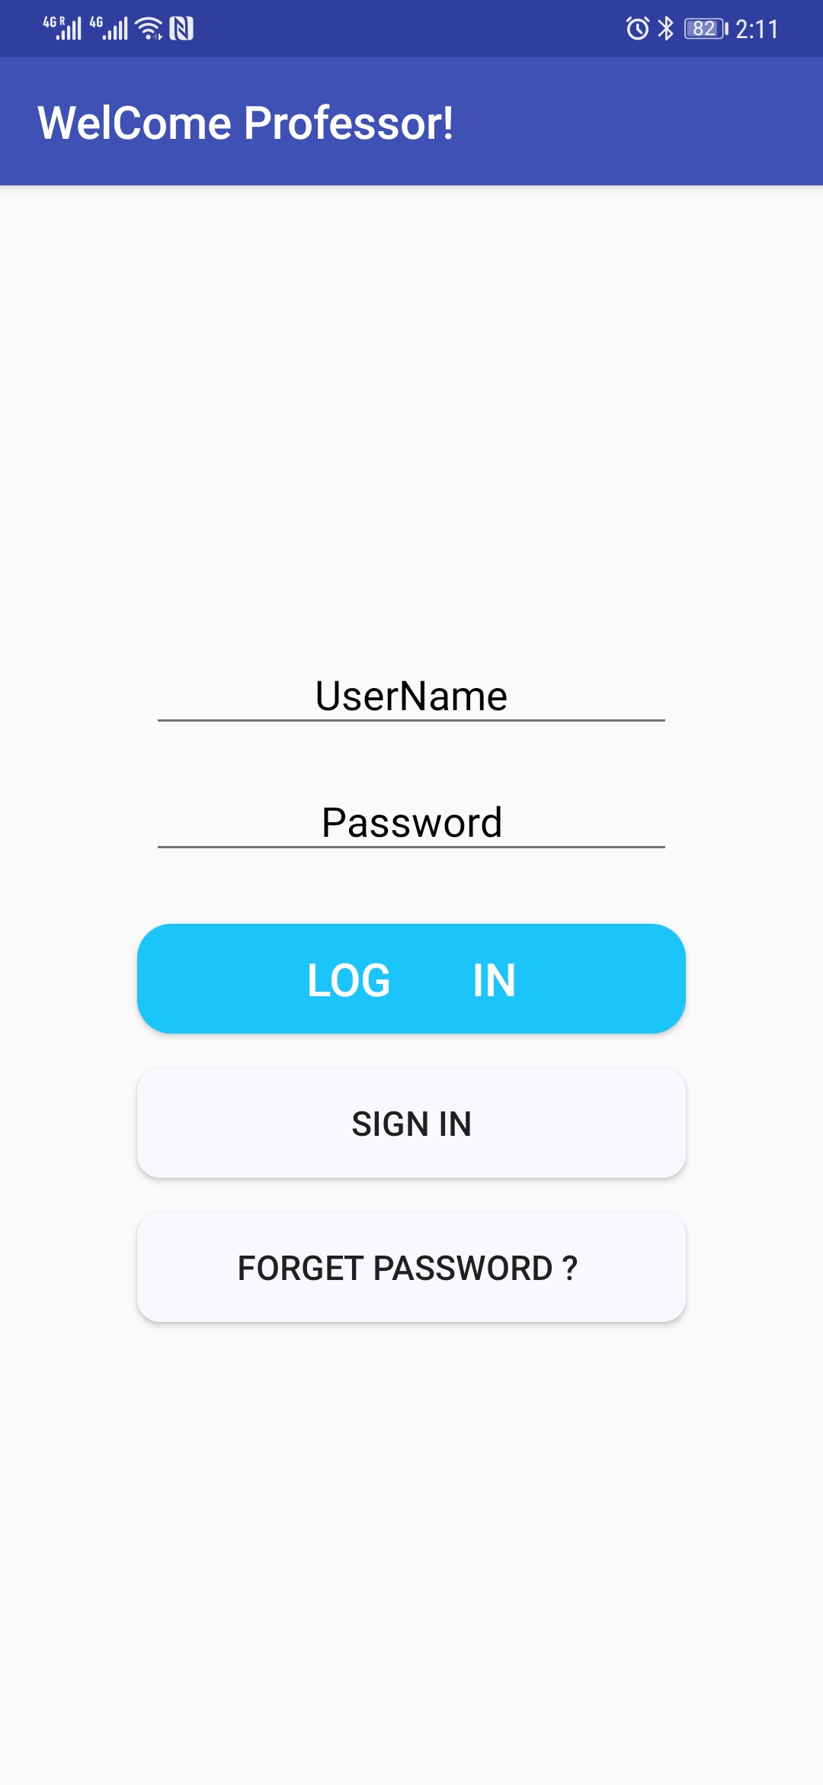
1. First Look

Slide 6

2. Register Username + password + Tel-number

Slide 7
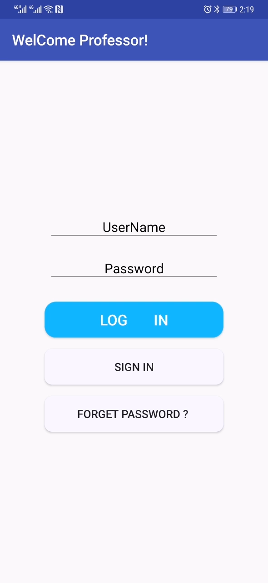
3 . Forget Password: Username + Tel-number

Slide 8
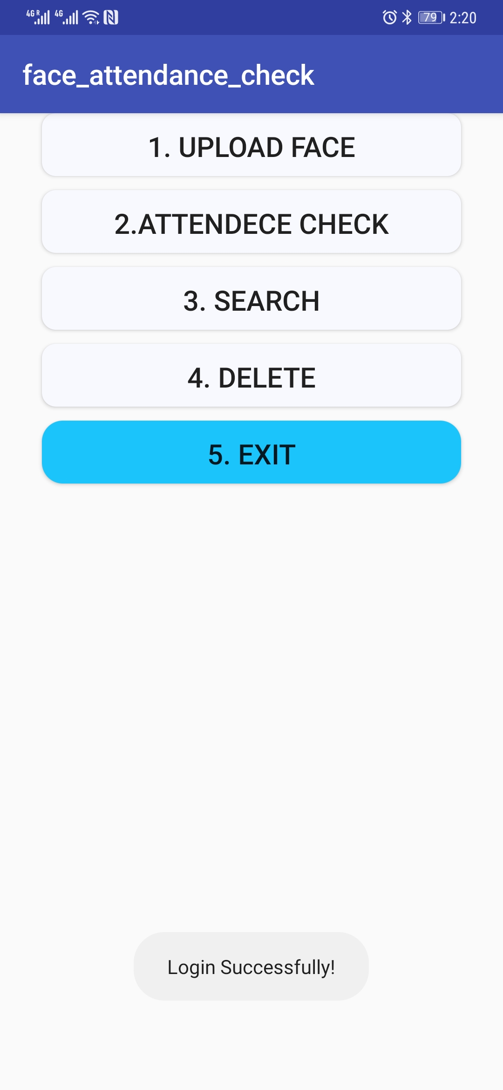
4. Log in: Username + password

Slide 9
5.1 Upload By Camera

Slide 10
5.2 Upload From Album

Slide 11

6. Search: Functions: (1) Show all saved faces : ID + Name; (2) Show all records of attendance check: ID + Check time; (3) Show all records in selected time slot: ID (all students) + Check time; (4) Search Check INFO by ID and Time: ID (students with selected ID) + Check time;

Slide 12

7. Attendance Check

Slide 13

8. Delete student Info

Slide 14
9. Exit: exit this app

Slide 15
Thanks for listening!
THE END

